Slide 1
Deployment of ML Model
Amazon Web Services
- Anshu Pandey

Slide 2
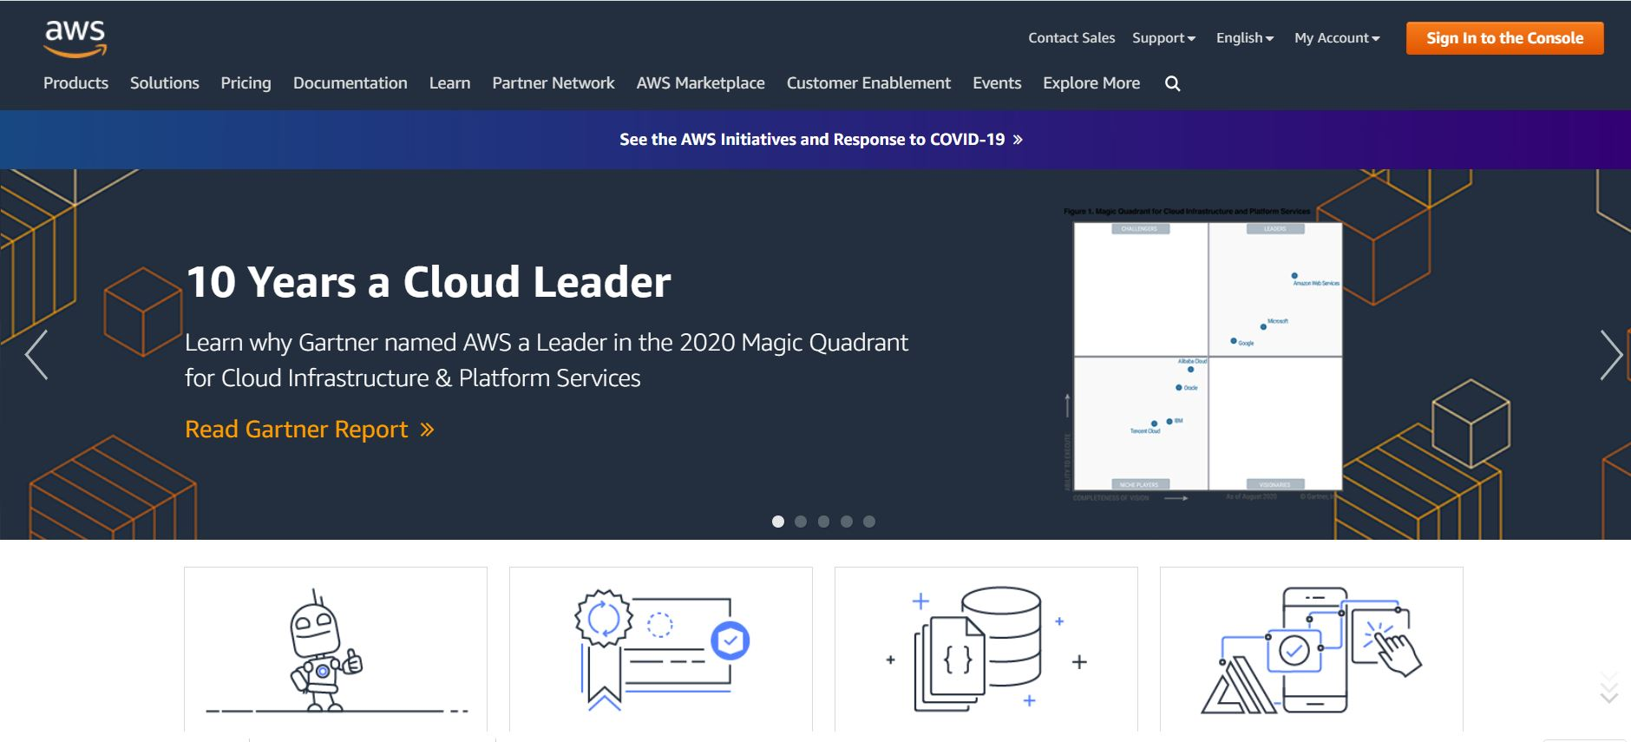
Step-1 – Create account on AWS

Slide 3
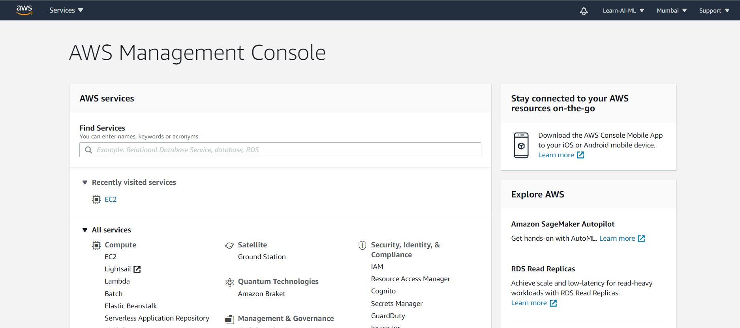
Step 2 – Search AWS EC2 Service

Slide 4
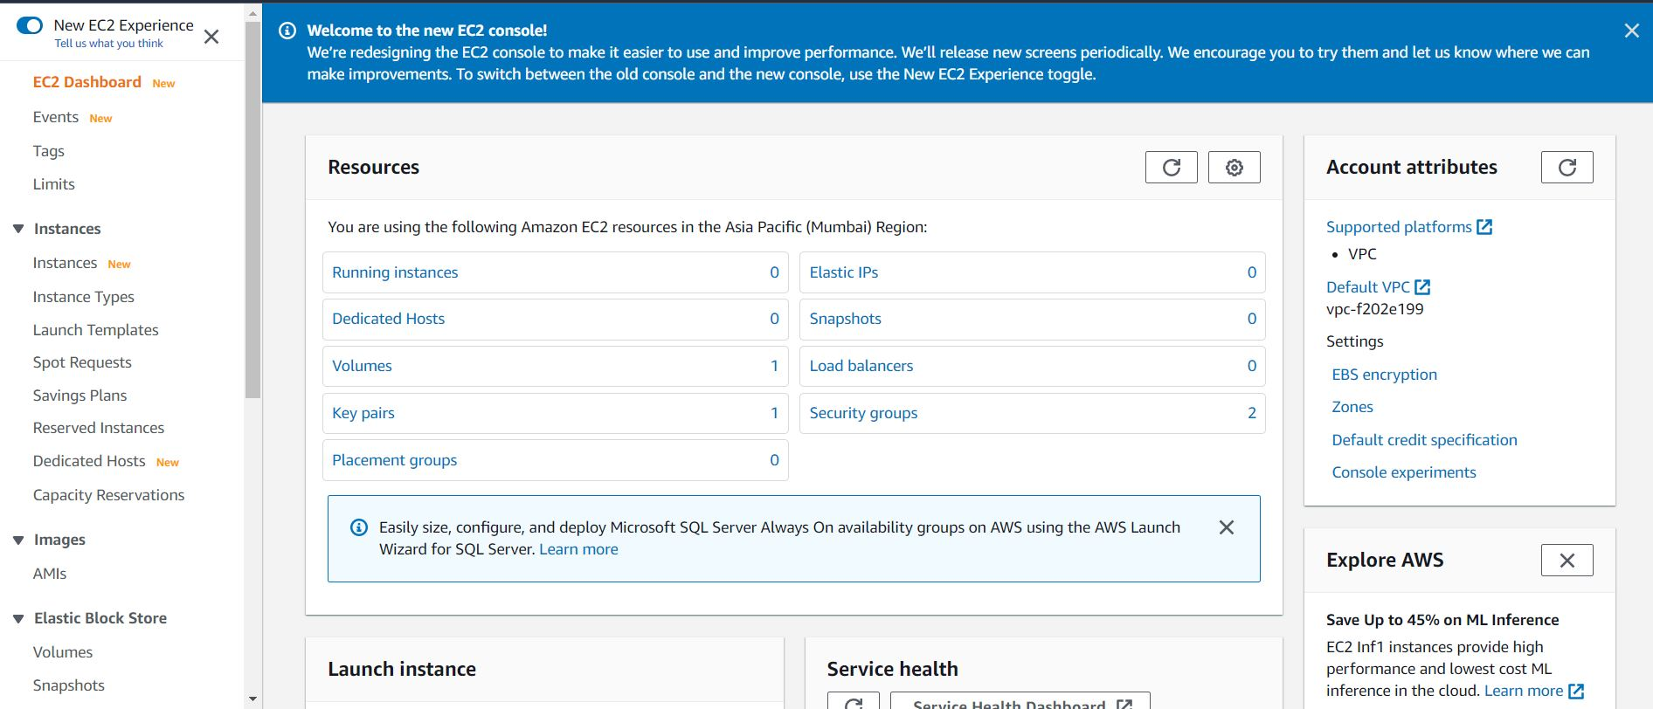
AWS EC2

Slide 5
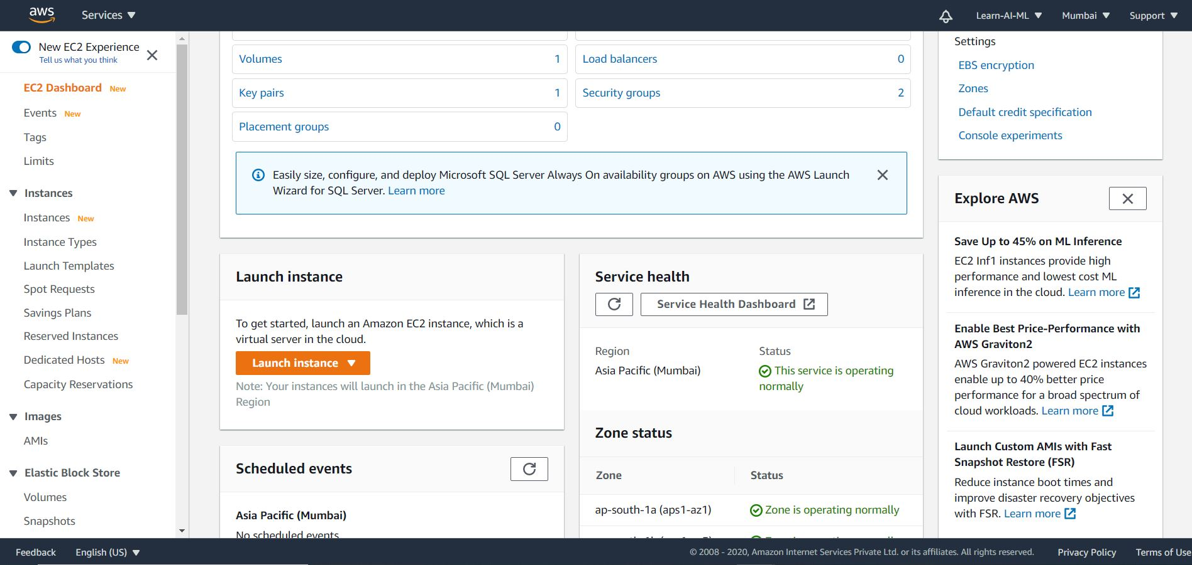
Launch Instance

Slide 6
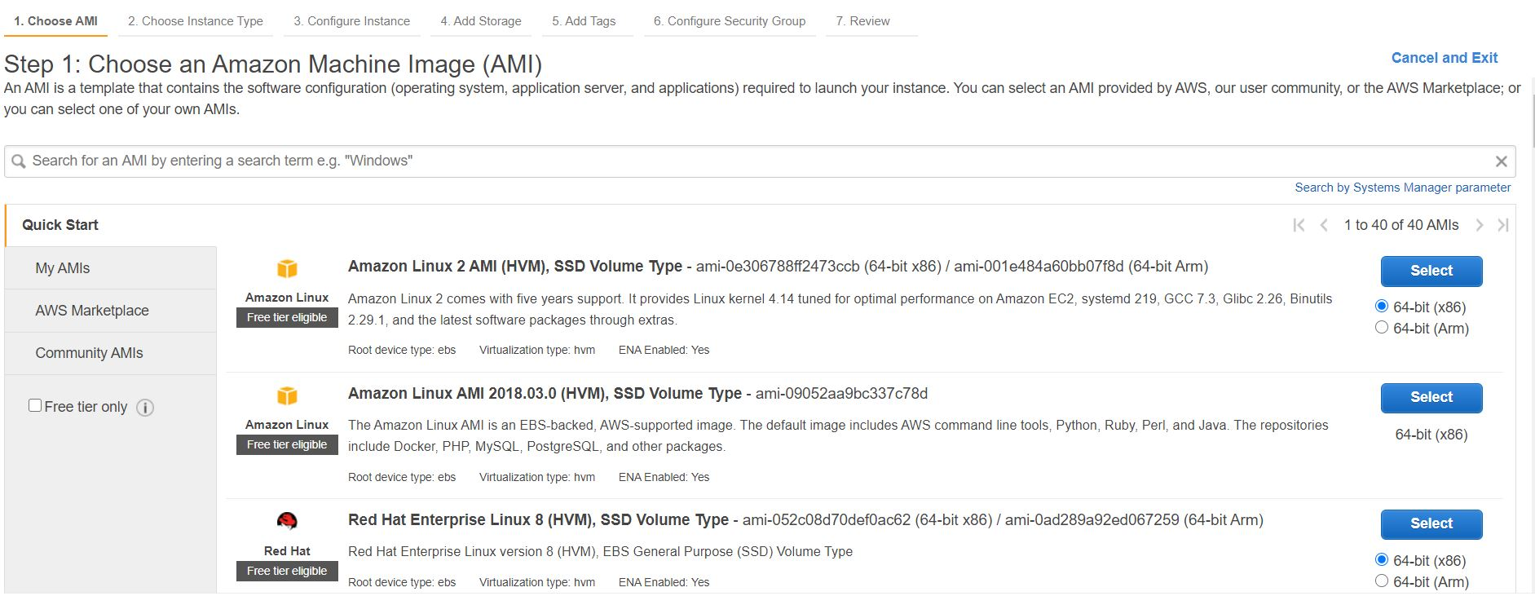
Select OS

Slide 7
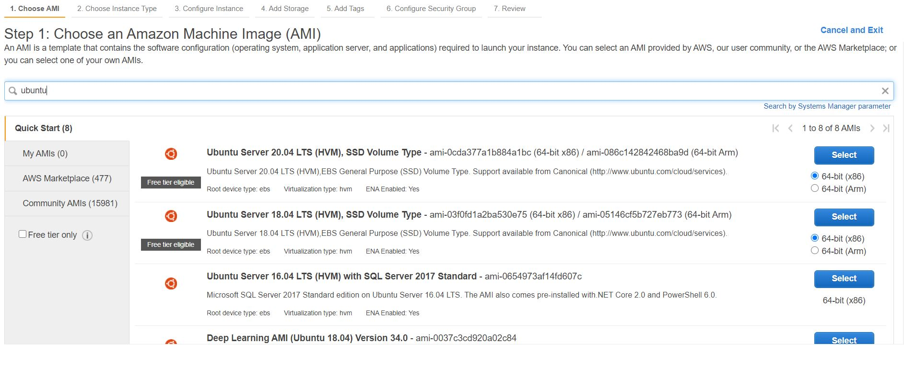
Ubuntu

Slide 8
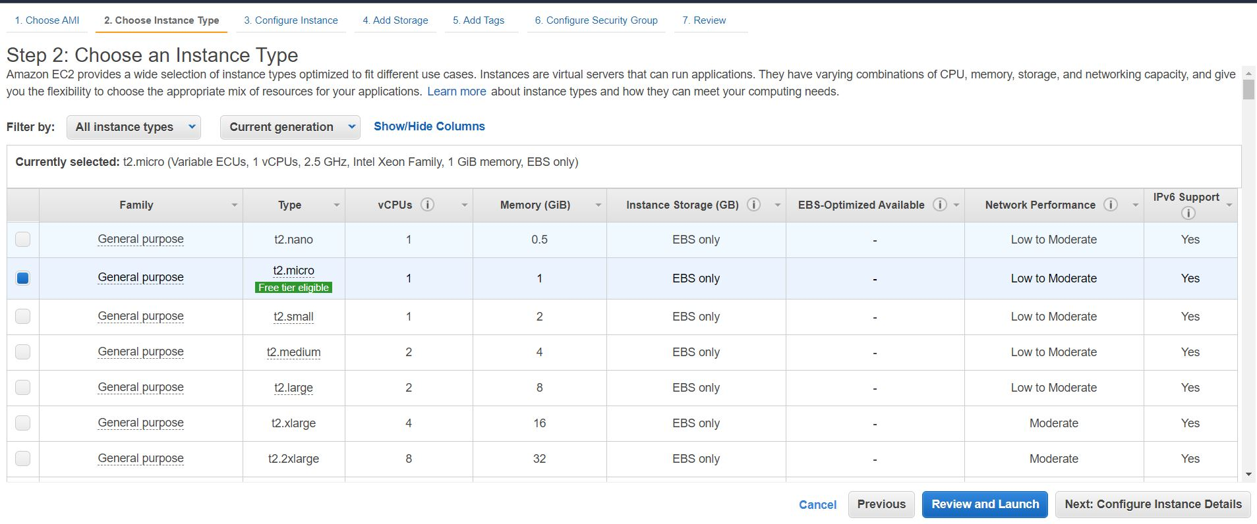
Click on Review and Launch

Slide 9
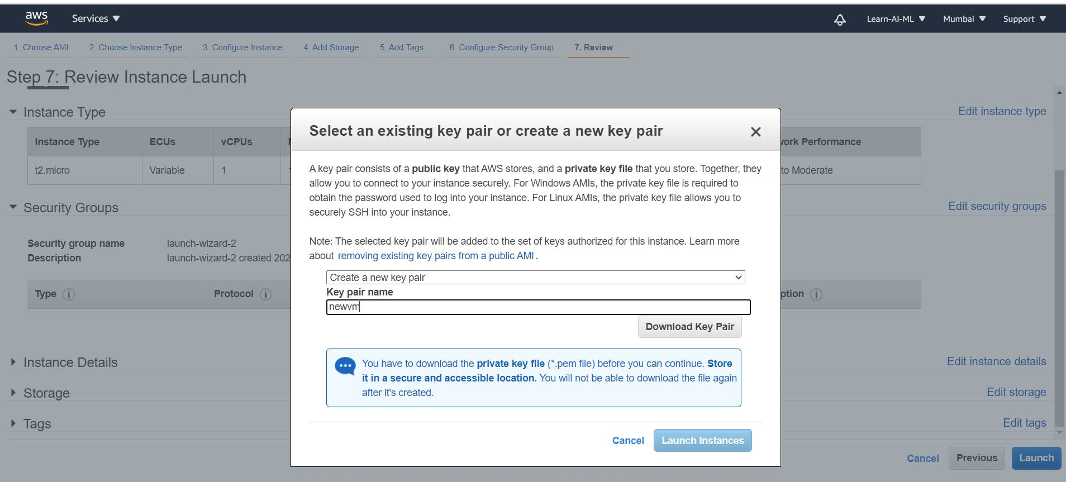
Create new key and download key pair

Slide 10

Launch Instance

Slide 11
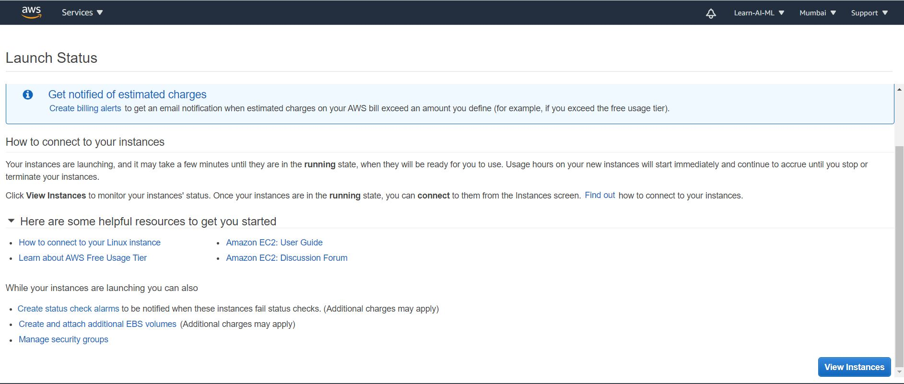
Click on view Instance

Slide 12
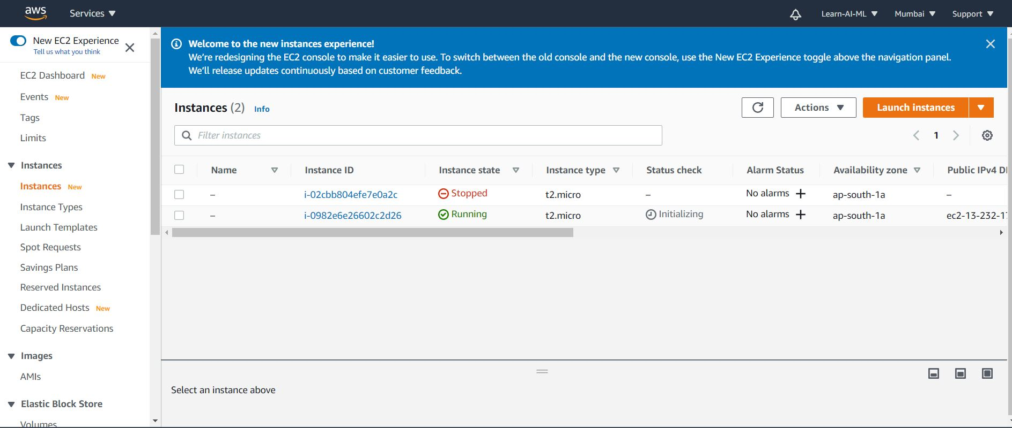
AWS EC2 Instance

Slide 13
Download software to connect with AWS EC2 and deploy ML model
PuTTY to access the VM via SSH
PuTTYgen (to create private key using pem file)
WinSCP (to deploy code to AWS EC2)
Download links
Putty = https://www.chiark.greenend.org.uk/~sgtatham/putty/latest.html
Puttygen = https://www.puttygen.com/download-putty
WinSCP = https://winscp.net/eng/download.php

Slide 14
Create Private key using PuTTYgen
Step 1: open PuTTYgen
Step 2: Navigate to File in the menu, select load private key, load pem file
Step 3: Save the private key

Slide 15
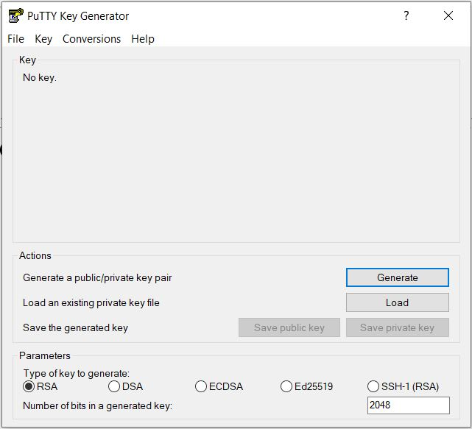
Open PuTTYgen

Slide 16
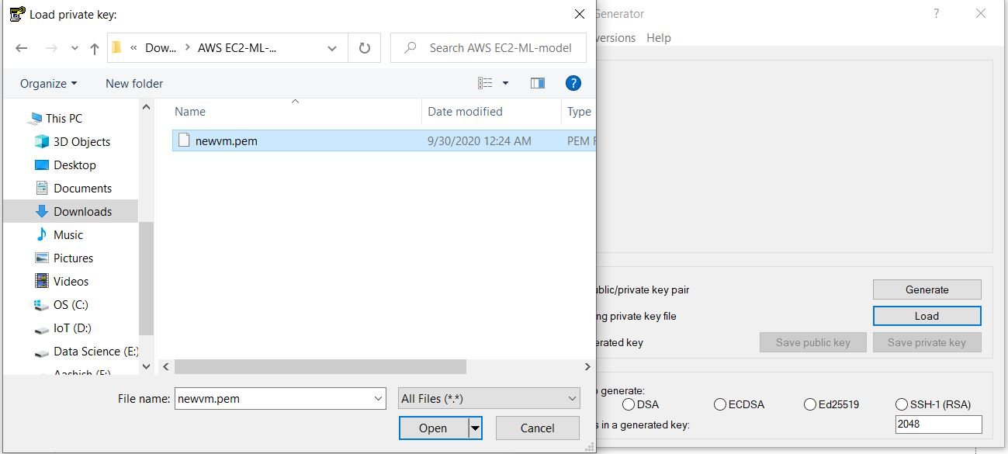
Select pem file then click on generate

Slide 17
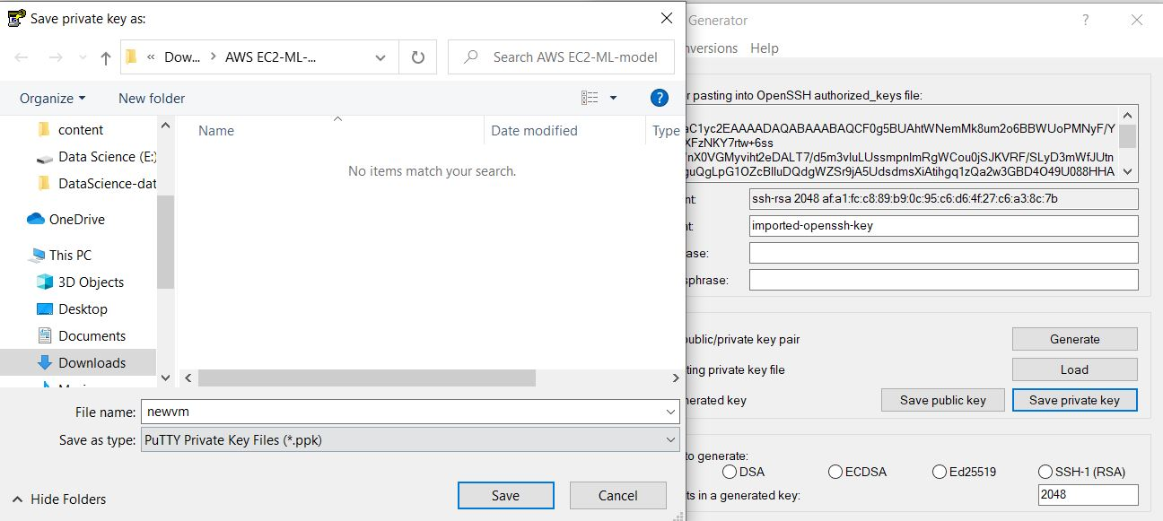
Click on save private key

Slide 18
Download WinSCP
https://winscp.net/eng/download.php

Slide 19
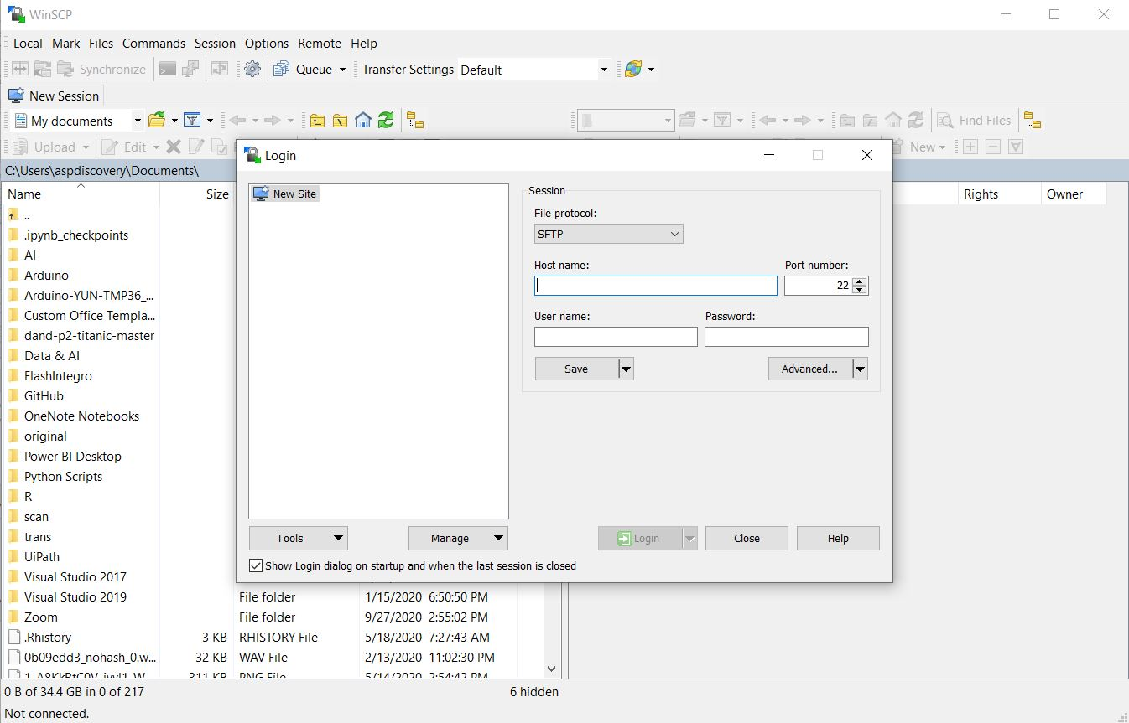
WinSCP

Slide 20
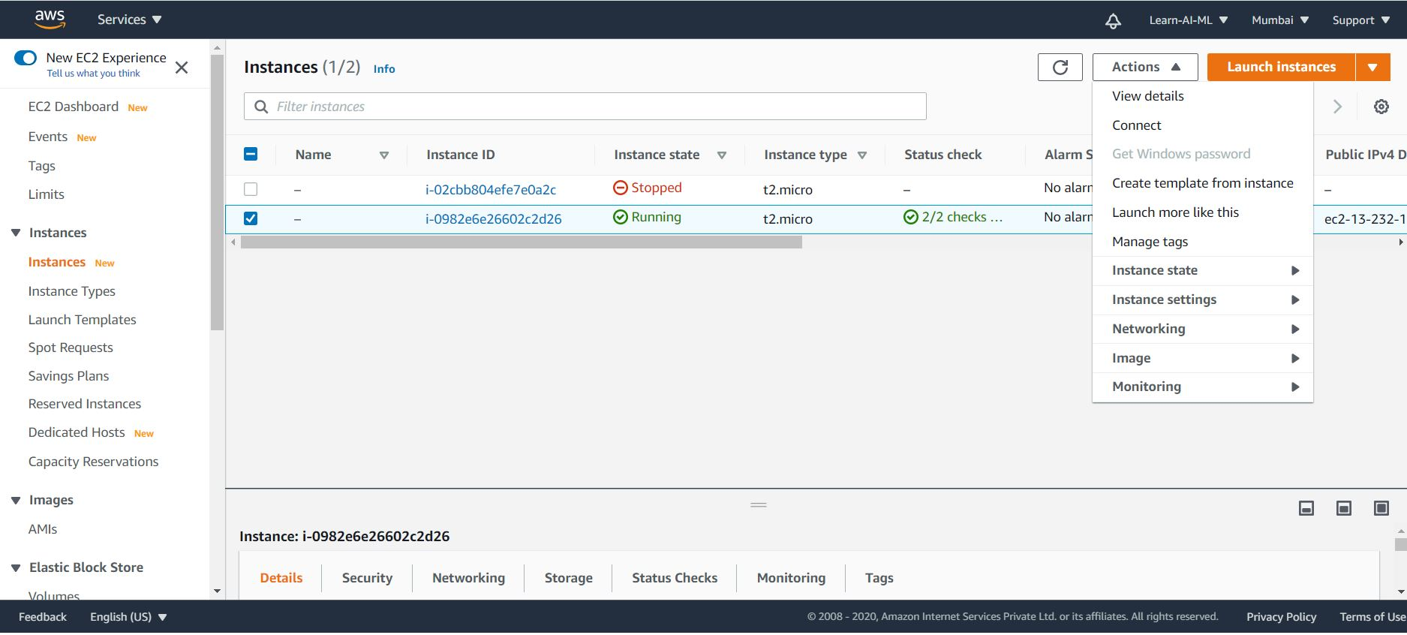
AWS EC2 instance select instance than click on connect

Slide 21
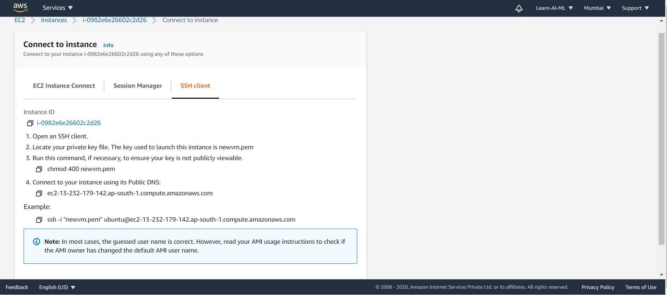
Click SSH client

Slide 22
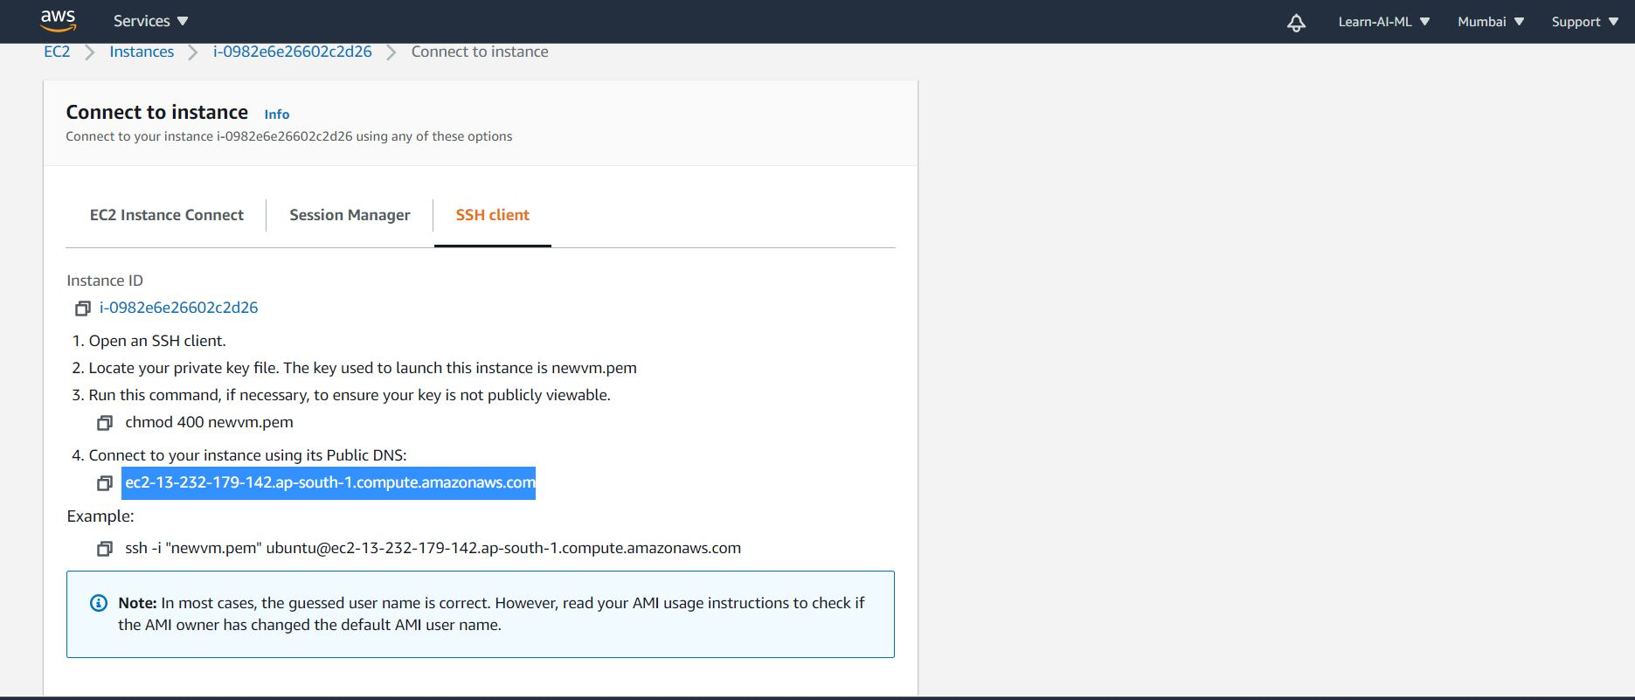
Copy Public DNS to connect with AWS EC2

Slide 23
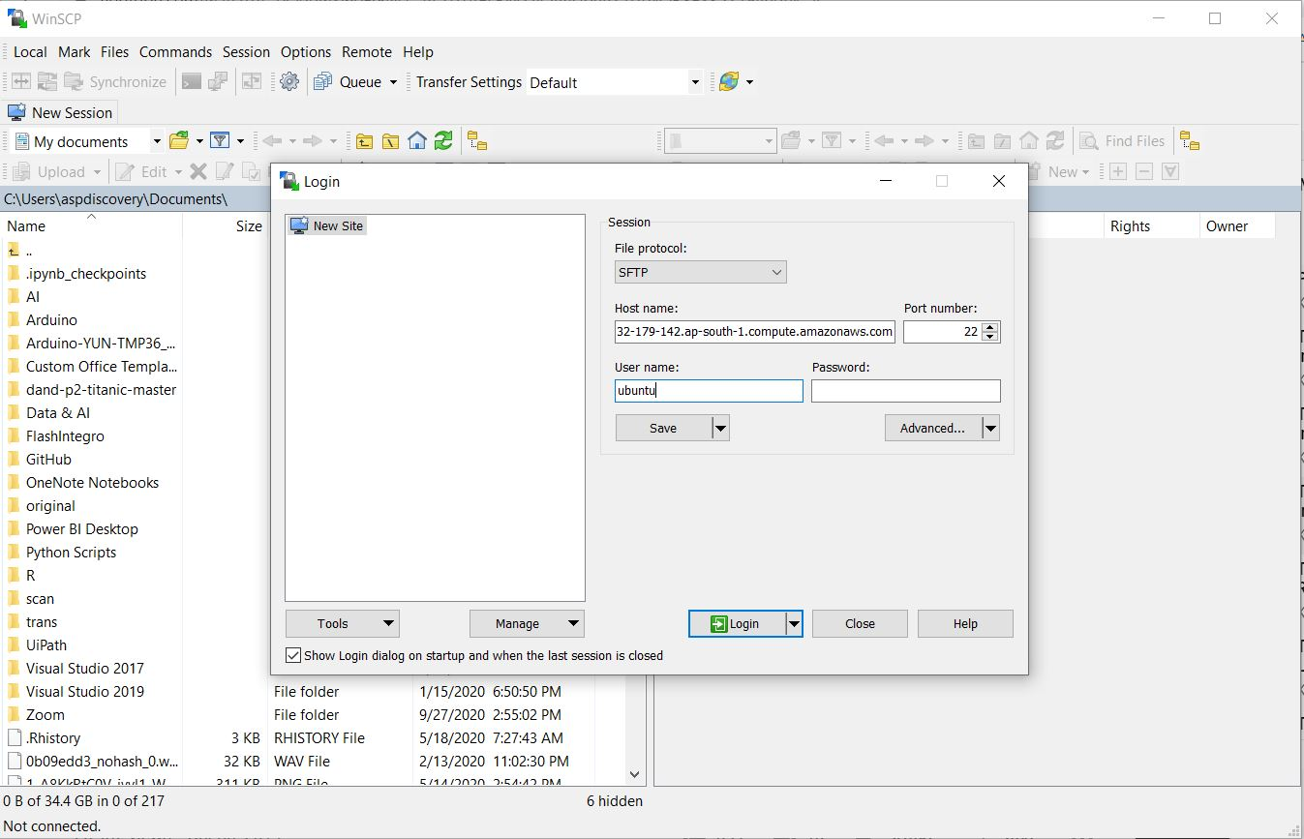
Paste into WinSCP than click on Advance

Slide 24
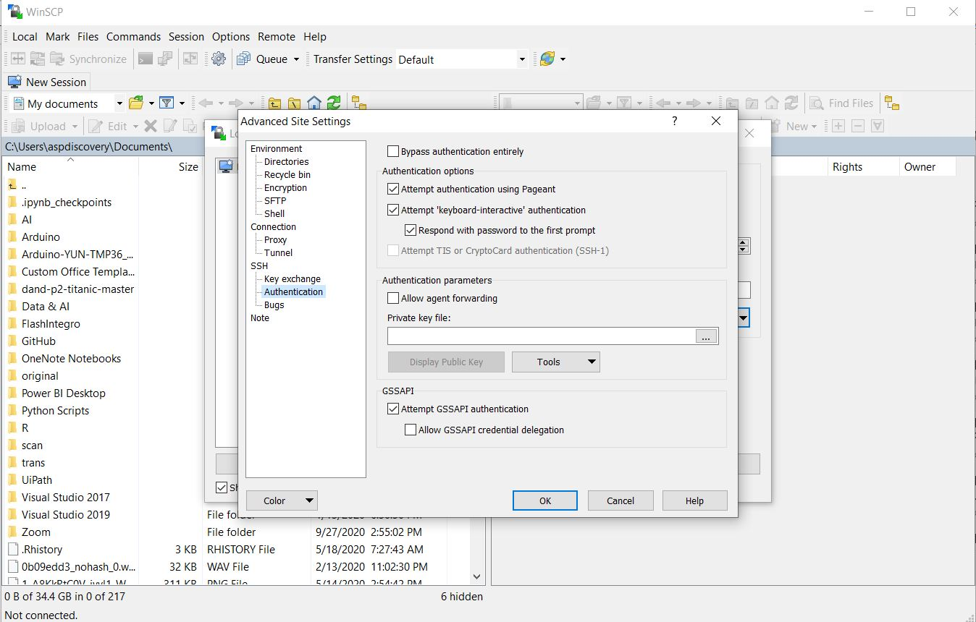
Select private key to connect with AWS EC2

Slide 25
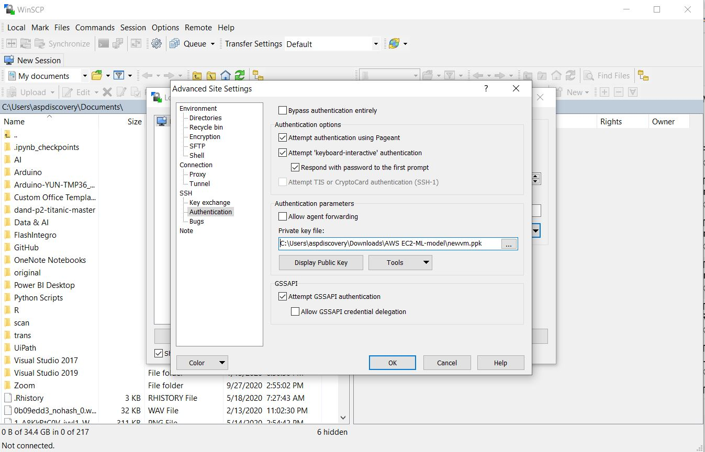
Click ok than click on Login

Slide 26
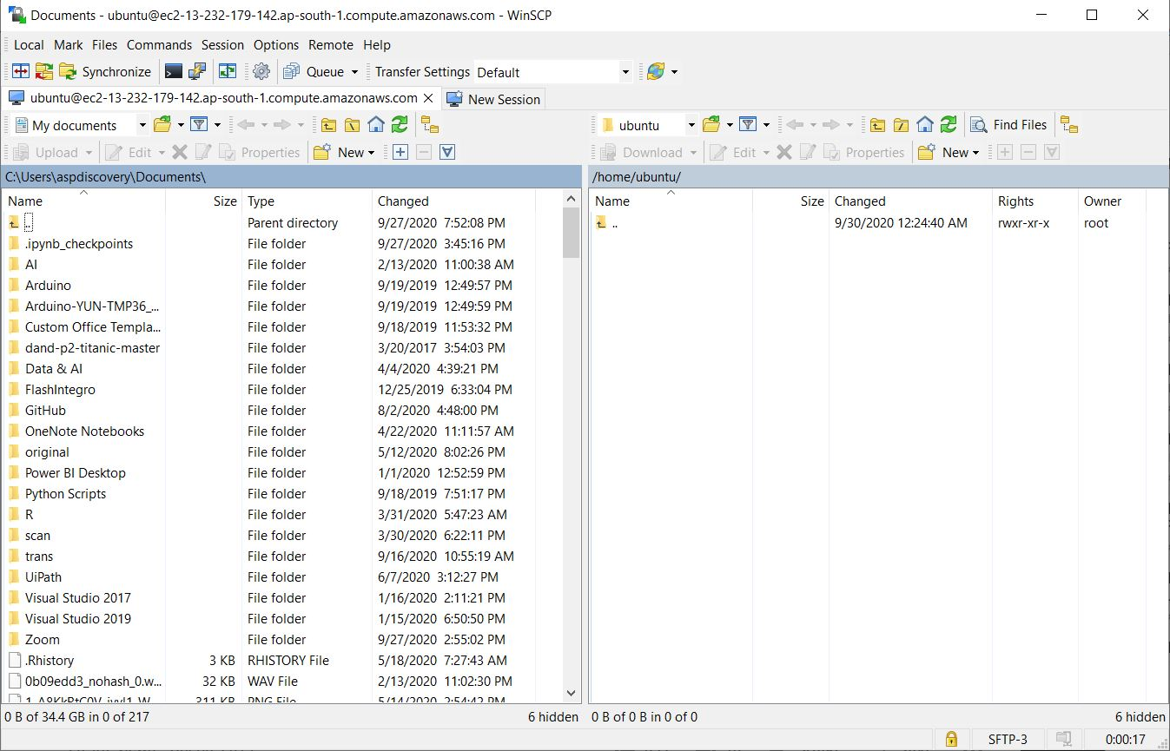
Your system (left side) and Ubuntu (right side)

Slide 27
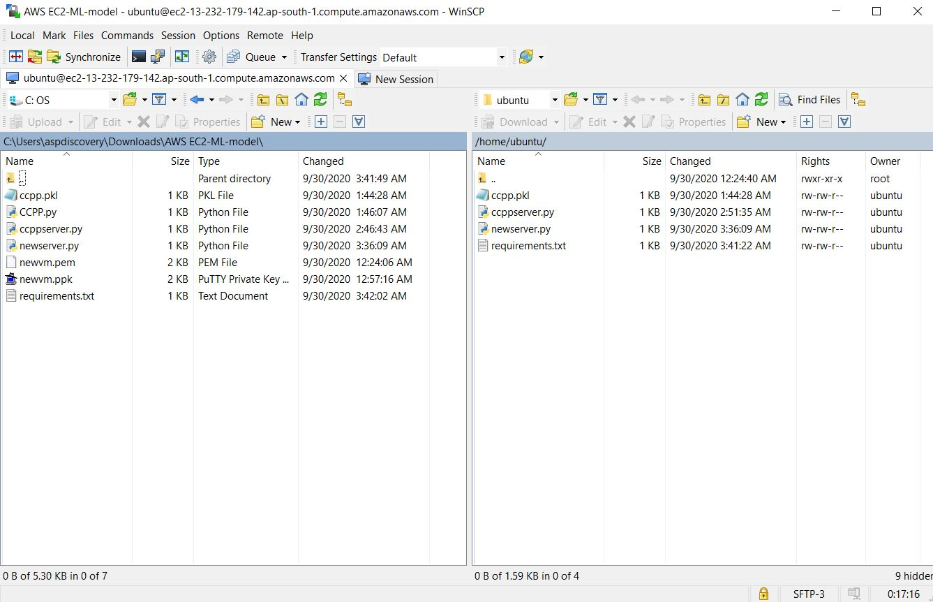
Paste code into AWS EC2 Instance (drag-drop)

Slide 28
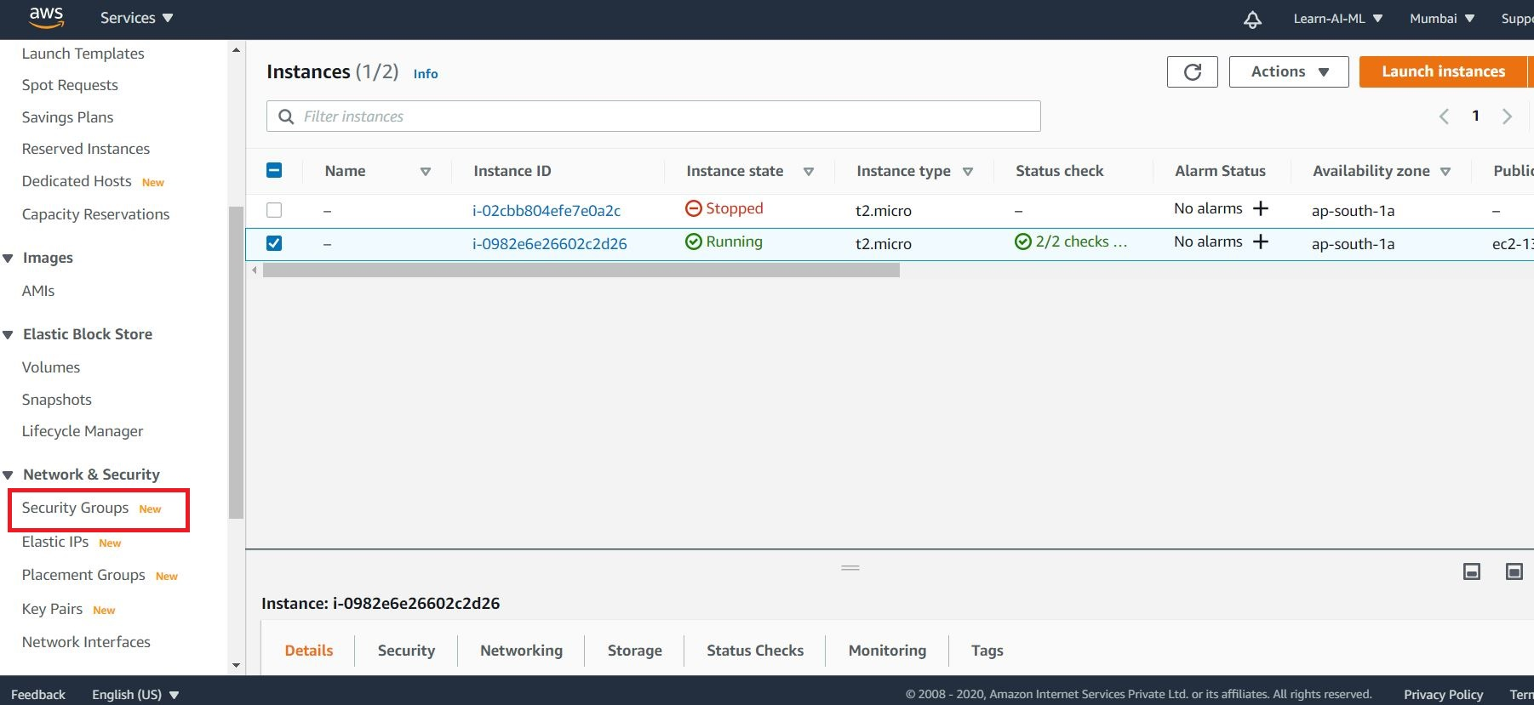
AWS security – to enable access from anywhere
Step 1) go to security group

Slide 29
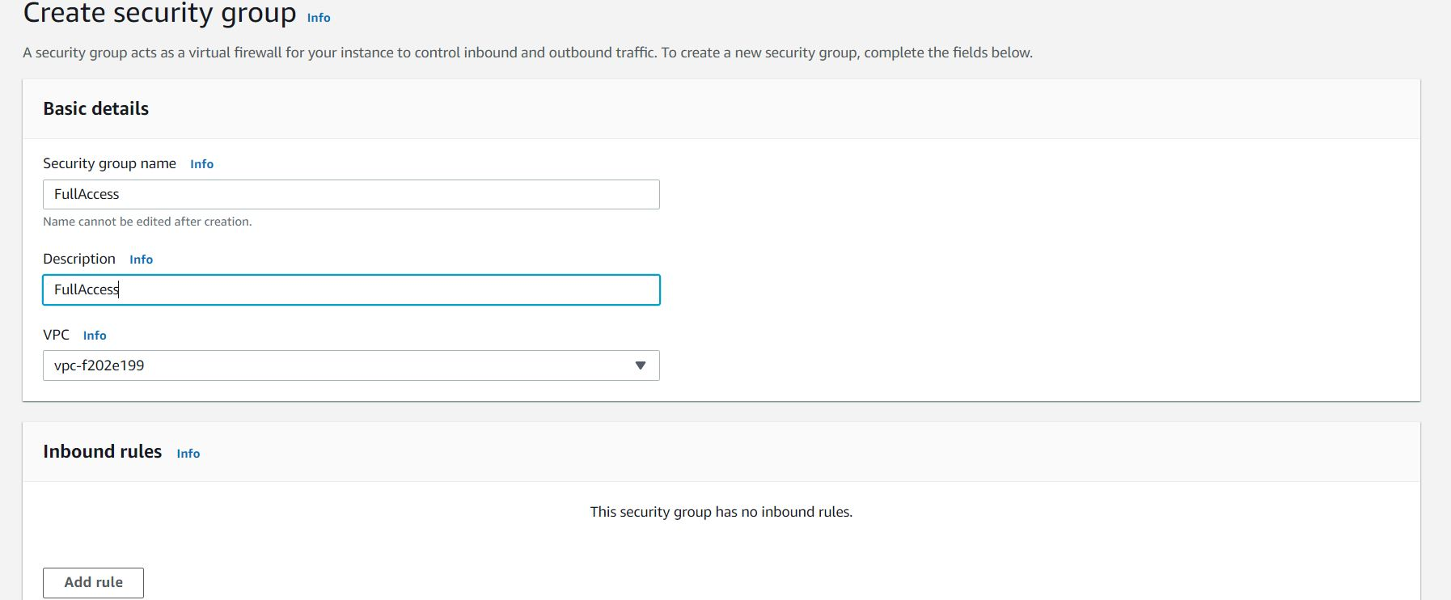
AWS security group > create new security group

Slide 30
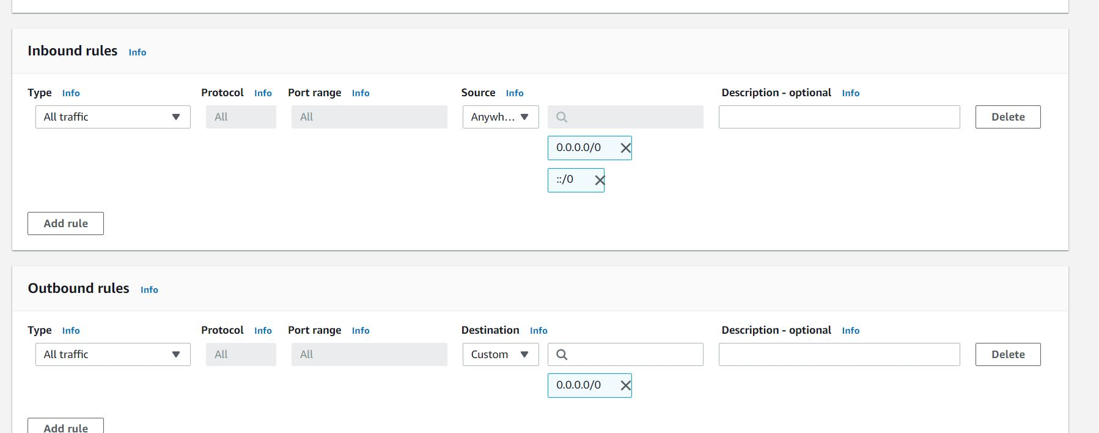
Add inbound rule than click on create security group

Slide 31
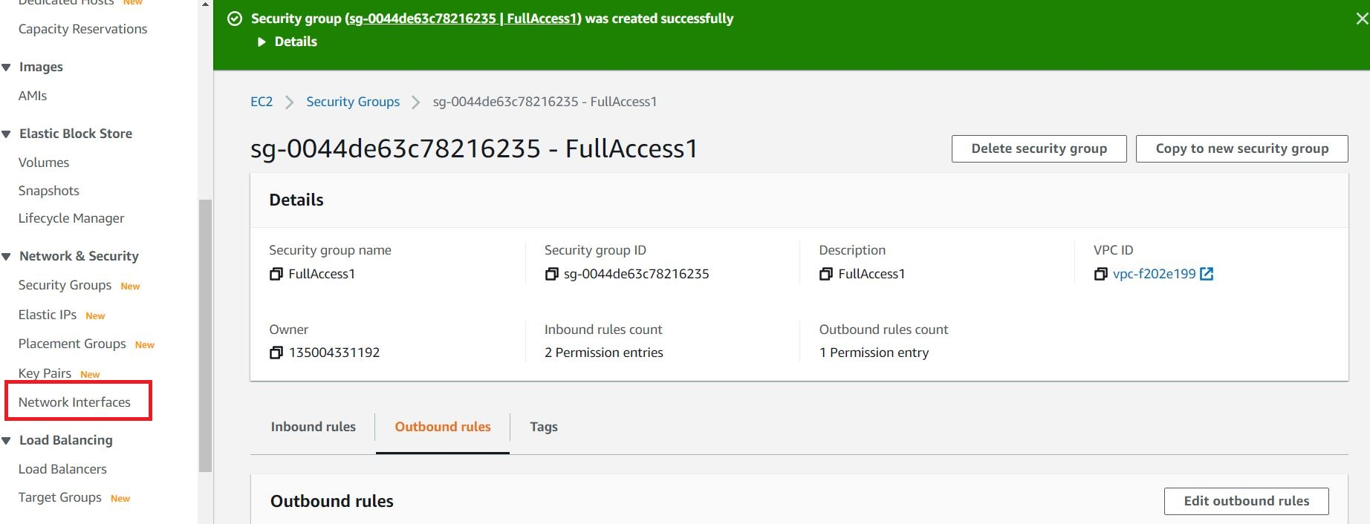
Click on Network Interface > to interface AWS Instance and security rule

Slide 32
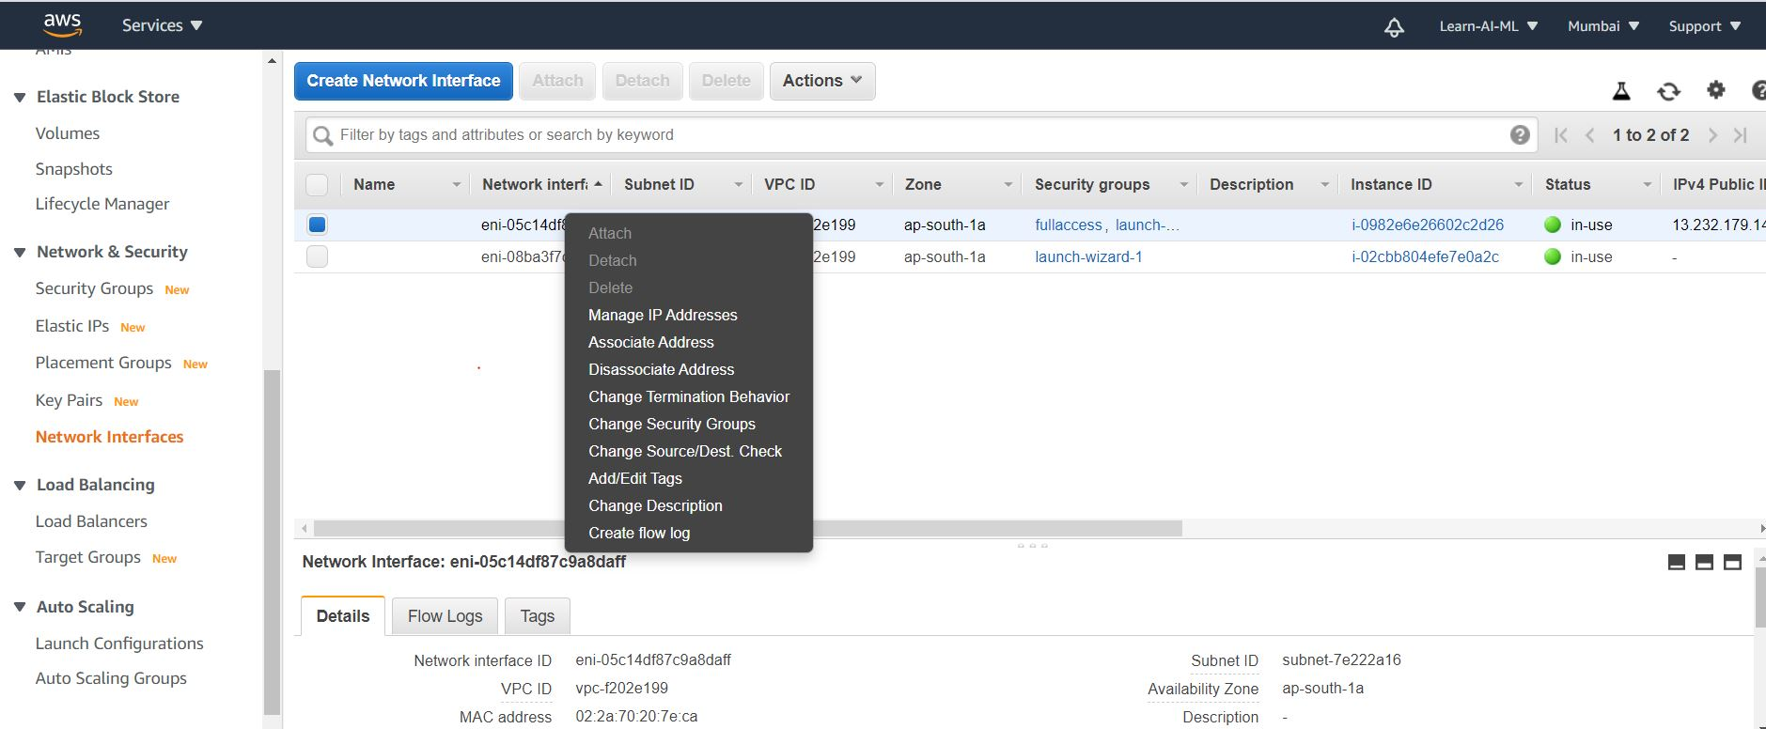
Right click on instance > change security group

Slide 33
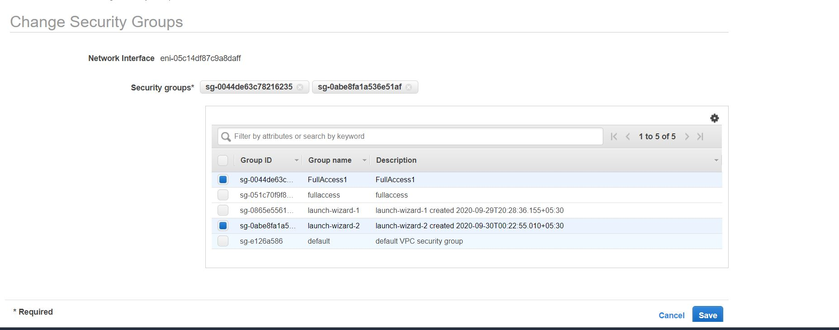
Select Security group and click on save

Slide 34
To Install require library in AWS EC2 instance
Open terminal using putty

Slide 35
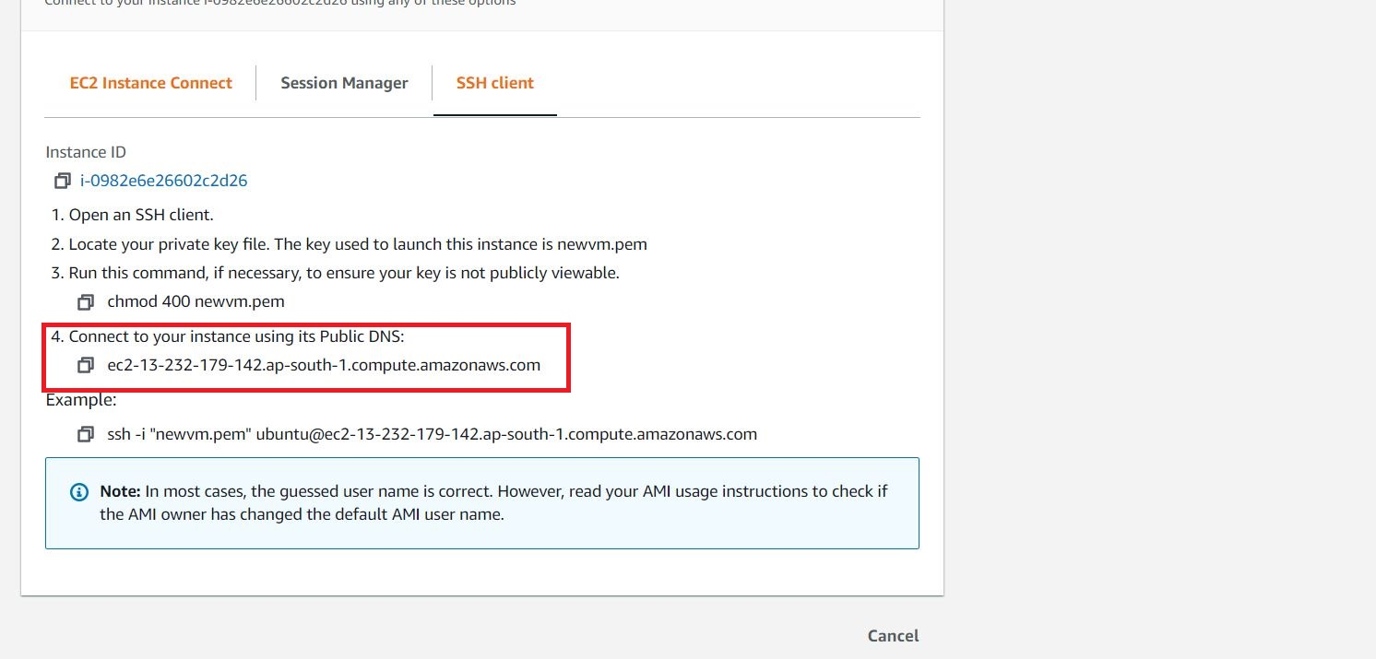
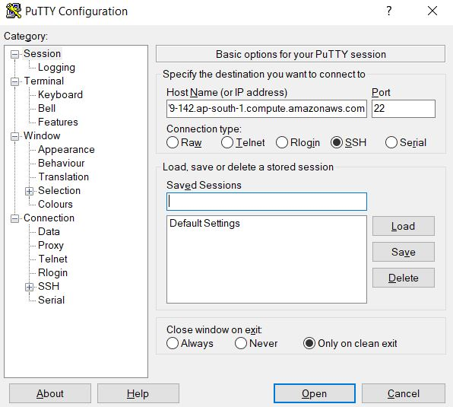
Copy public DNS

Slide 36
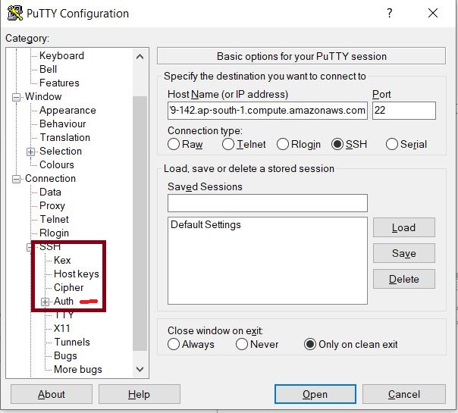
Pate DNS as IP address and click on SSH > Auth

Slide 37
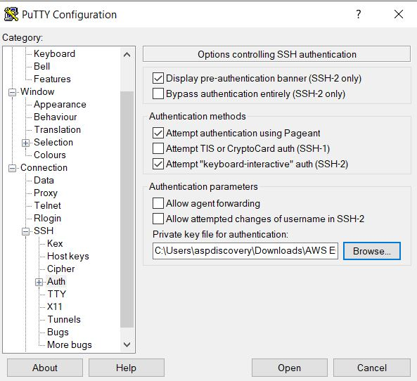
Load private key

Slide 38
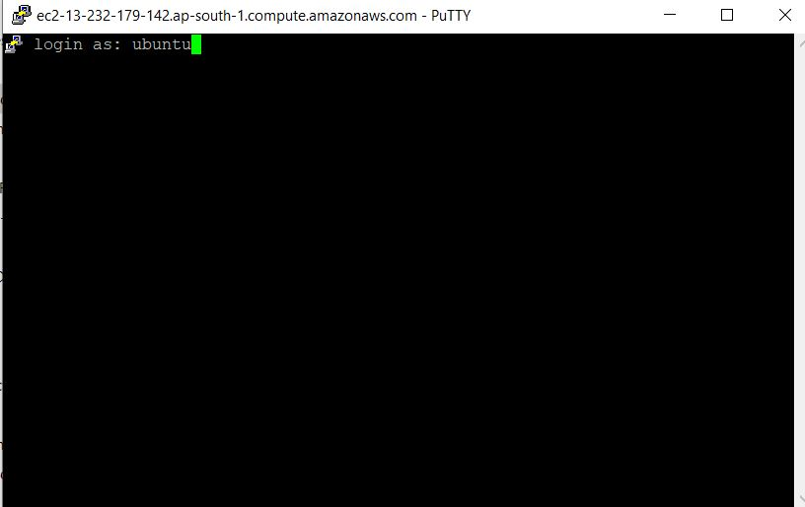
Login terminal AWS EC2 Instance

Slide 39
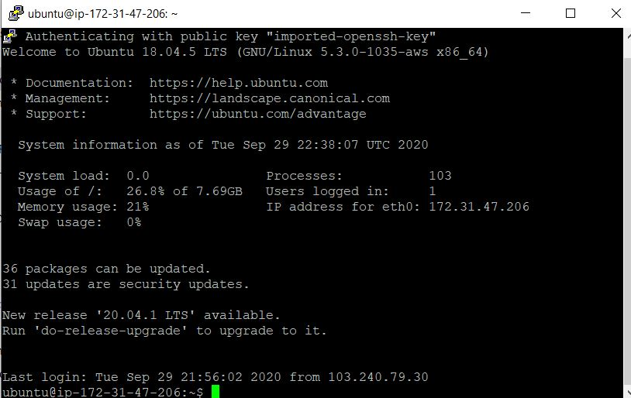
AWS EC2

Slide 40
Entre command
pwd
ls
sudo apt-get update && sudo apt-get install python3-pip
Pip3 install numpy pandas scikit-learn joblib flask matplotlib scipy
Python3 webapp.py

Slide 41
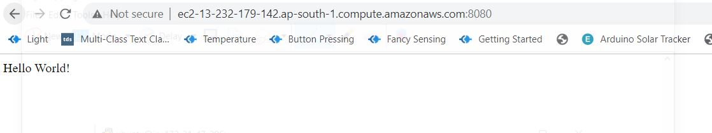
Open web browser entre http://ec2-13-232-179-142.ap-south-1.compute.amazonaws.com:8080/

Slide 42
All Steps
Flask Code
Run and Check in Local
Create AWS account
Create EC2 instance
Download putty and puttygen
Generate private key using putty gen
Download WinSCP
Access AWS EC2 Instance and paste code and all required file

Slide 43
All Steps
Login terminal window using putty
Install all required libraries
Run program – python3 webapp.py
Perform testing using endpoint (public DNS)

Slide 44

Thank You

